Slide 1

Data Science Bootcamp
LOAN ELIGIBILITY PREDICTIONS
Name: GHEESAH
First Name: Richard

Slide 2

Process
Dataset overview & problem
Data preprocessing & Visualization
Machine Learning models & solutions

Slide 3
Dataset overview
Among all industries, insurance domain has the largest use of analytics & data science methods. This data set would provide you enough taste of working on data sets from insurance companies, what challenges are faced, what strategies are used, which variables influence the outcome etc. This is a classification problem. The data has 615 rows and 13 columns.
Problem
Company wants to automate the loan eligibility process (real time) based on customer detail provided while filling online application form. These details are Gender, Marital Status, Education, Number of Dependents, Income, Loan Amount, Credit History and others. To automate this process, they have given a problem to identify the customers segments, those are eligible for loan amount so that they can specifically target these customers. Here they have provided a partial data set.

Slide 4
Data preprocessing & visualization
Data cleaning
Visualization

Slide 5
Data cleaning
Percentage of missing values per column:
“Credit History” : 8.14 %
“Self Employed” : 5.21 %
“Loan Amount“ : 3.58 %
“Dependents” : 2.44 %
“Loan Amount Term” : 2.28 %
“Gender” : 2.12 %
“Married” : 0.49 %

Slide 6
Columns analysis:
to remove : “Loan_ID”
target : “Loan Status”
Explanatory columns : "Gender","Married",
"Dependents","Education","Self_Employed","ApplicantIncome","CoapplicantIncome","LoanAmount",
"Loan_Amount_Term","Credit_History","Property_Area"

Slide 7
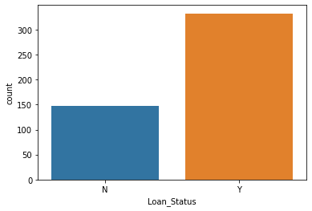
Loan status :
Data Visualization
There is 69.17 % of loans accepted
There is 30.83 % of loans rejected

Slide 8
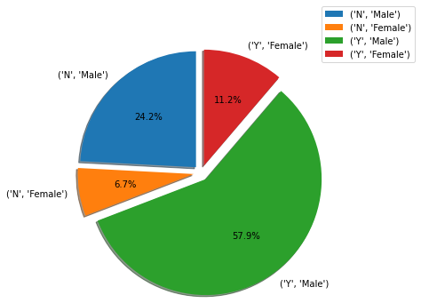
Repartition of loan status per gender:

Slide 9
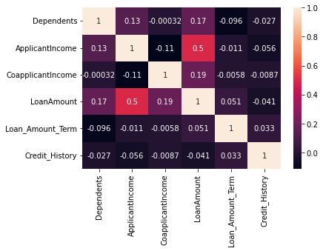
Correlation matrix :
There is a significant correlation between the Loan Amount & the Applicant Income

Slide 10
Machine Learning
Models : Nominal classification problem
Solutions

Slide 11
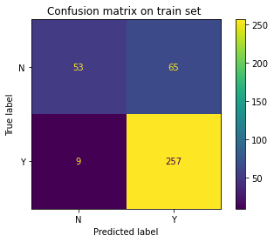
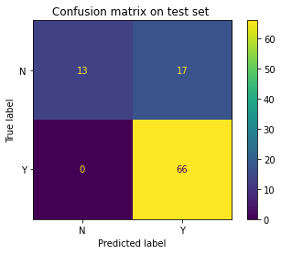
We first trained a Logistic Regression Model :
accuracy-score on train set : 0.81
f1-score on training set: 0.87
accuracy-score on test set : 0.82
f1-score on test set : 0.89

Slide 12
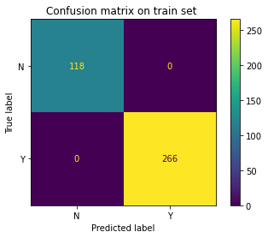
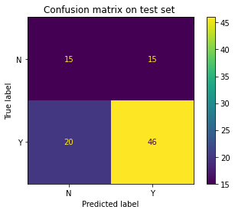
We then trained a Decision Tree Classifier Model :
accuracy-score on train set : 1.0
f1-score on training set: 1.0
accuracy-score on test set : 0.64
f1-score on test set : 0.71
OVERFITTING !!!

Slide 13
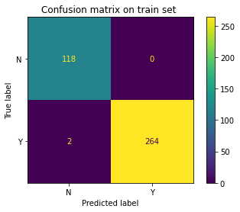
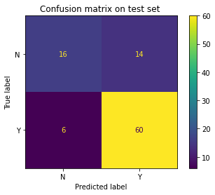
We eventually trained a Random Forest Classifier Model :
accuracy-score on train set : 0.99
f1-score on training set: 1.0
accuracy-score on test set : 0.79
f1-score on test set : 0.86
still OVERFITTING…

Slide 14
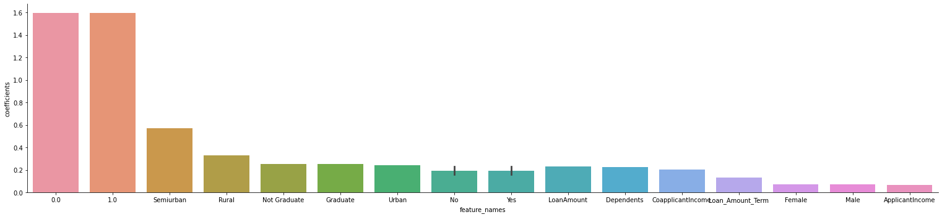
Let’s check features importance :

Slide 15
Conclusion
To automate the loan eligibility process we chose the Logistic Regression classification model.
As per this model the most important features are the Credit history & the Property Area.

Slide 16

Thanks,
See you soon !

